Slide 1
Data Science with Python Career Program – Capstone Project - By Shivam Shrotriya

Slide 2
Index
S. No. | Particulars | Page No.
1. | Data Summary Data Information Data Structure & Size with Snapshot Data Quality Descriptive Statistical Details Data Insights & Graphs | 3 – 6 3 3-4 5 5 5-6
2. | EDA & Graphical Analysis Exploratory Data Analysis Graphical Analysis Conclusion & Reference File | 7-22 7-11 12-21 22
3. | Data Cleaning & Data Preprocessing Data Cleaning Data Preprocessing | 23-27 23-25 26-27
4. | Machine Learning Model Selection Feeding data Model Training and Prediction on Test Data Model Evaluation and Model Selection Model Saving | 28-31 28 28-30 31 31
5. | Github & Streamlit Website Screenshot and Links Github Files Screenshot Streamlit Website Screenshot Reference Links | 32-34 32 33 34

Slide 3
1. Data Summary
Dataset Information:-
Name of the Data set :- Used Car Sales Details.
Description :- Dataset contains information about Historical data of used cars with selling price.
Data Structure and Size :-
Number of Observation:- The dataset contains 4340 number of rows.
Number of Variables and its type:- The dataset contains multiple variables representing different aspects of the used cars, categorized by their types.
Categorical Variables:
1. Name: Represents the brand and model of the cars.
2. Seller Type: Classifies the sellers into three categories:
- Individual: Refers to private individuals selling their personal vehicles.
- Dealer: Represents professional car dealerships involved in buying and selling used cars.
- Trustmark Dealer: Denotes dealers certified or recognized for meeting specific quality and customer service standards.
3. Fuel Type: Specifies the type of fuel used by the cars.
4. Transmission: Indicates the type of transmission system, such as automatic or manual.
5. Owner: Categorizes the ownership history of the cars, including first owner, second owner, third owner, fourth and above owner, or test drive owner.
Numerical Variables:
1. Year: Represents the manufacturing or launch year of the cars.
2. Selling Price: Denotes the price at which the used cars were sold.
3. KM Driven: Indicates the distance or mileage covered by the cars.
These variables capture important information about the used cars, including their brand and model, seller type (individual, dealer, or trustmark dealer), fuel type, transmission, ownership history, manufacturing year, selling price, and mileage.

Slide 4
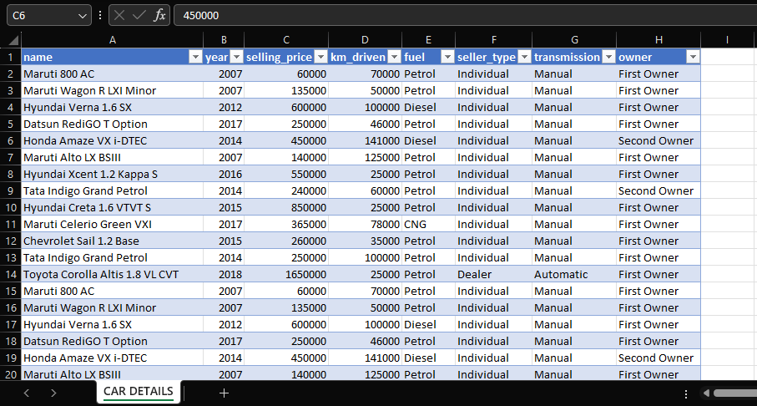

Slide 5
Data Quality :-
This dataset exhibits some data quality issues that need consideration. Specially, there are instances of duplicate values in the dataset, affecting variable such as selling price and kilometre driven. Additionally, outliers are observed in these variables, which may impact data analysis and interpretation. These data quality issues should be addressed to ensure accurate and reliable analysis.
Descriptive Statistical details:-
Selling_Price :-
Range :- ₹ 20000 to ₹ 8900000.
Mean:- ₹ 504127.32
Median:- ₹ 350000
Standard Deviation :- ₹ 578548.74
Km_driven:-
Range :- 1 km to 806599 km.
Mean:- 66215.78 km
Median:- 60000km
Standard Deviation :- 46644,10 km
Data Insights:-
1. The average selling price of used cars in the dataset is ₹5,04,127.32, with a median of ₹ 3,50,000. The distribution of selling prices is positively skewed, suggesting that higher-priced vehicles are relatively less common.
2. The average kilometer driven for the used cars is 66215.78 km ,with a median of 60000 km. The distribution of kilometer driven is positively skewed, indicating that cars with lower mileage are more prevalent in the dataset.
3. Outliers are observed in both the selling price and kilometer driven variables, indicating the presence of extremely high or low values. These outliers may represent rare or unique car models, data entry errors, or extreme market conditions.
4. Further investigation is required to analyze the impact of outliers on data analysis and modeling, as they can significantly influence summary statistics and derived insights.

Slide 6
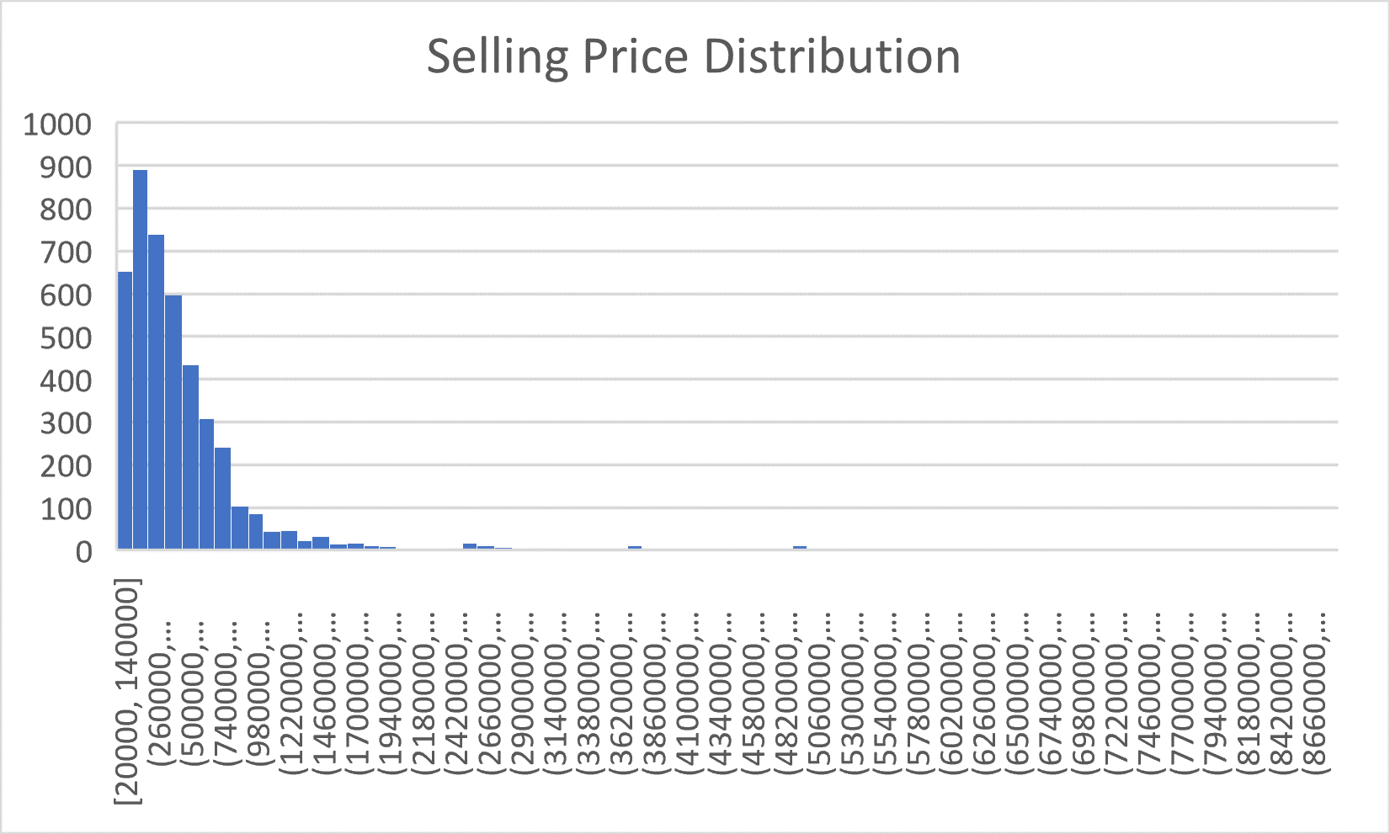
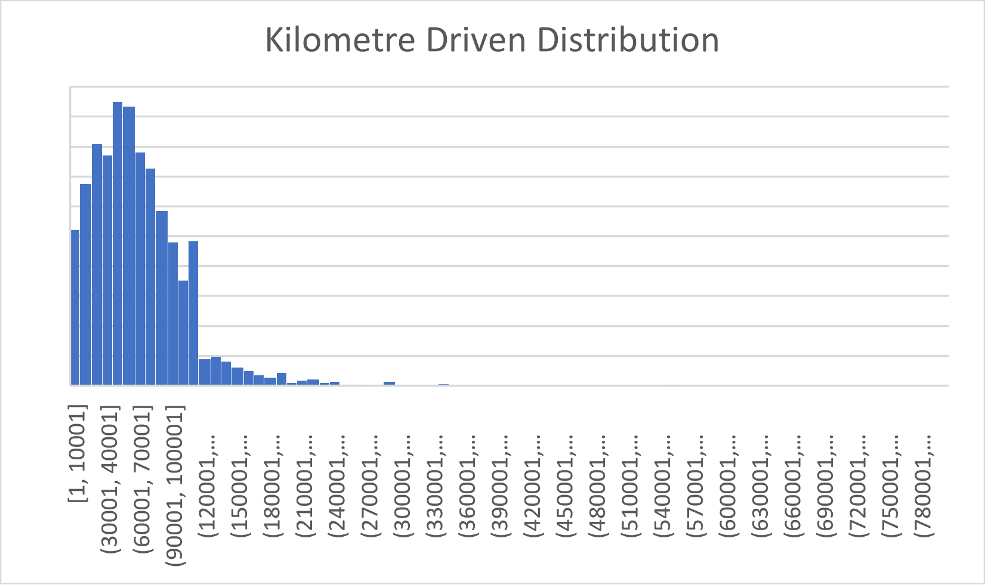
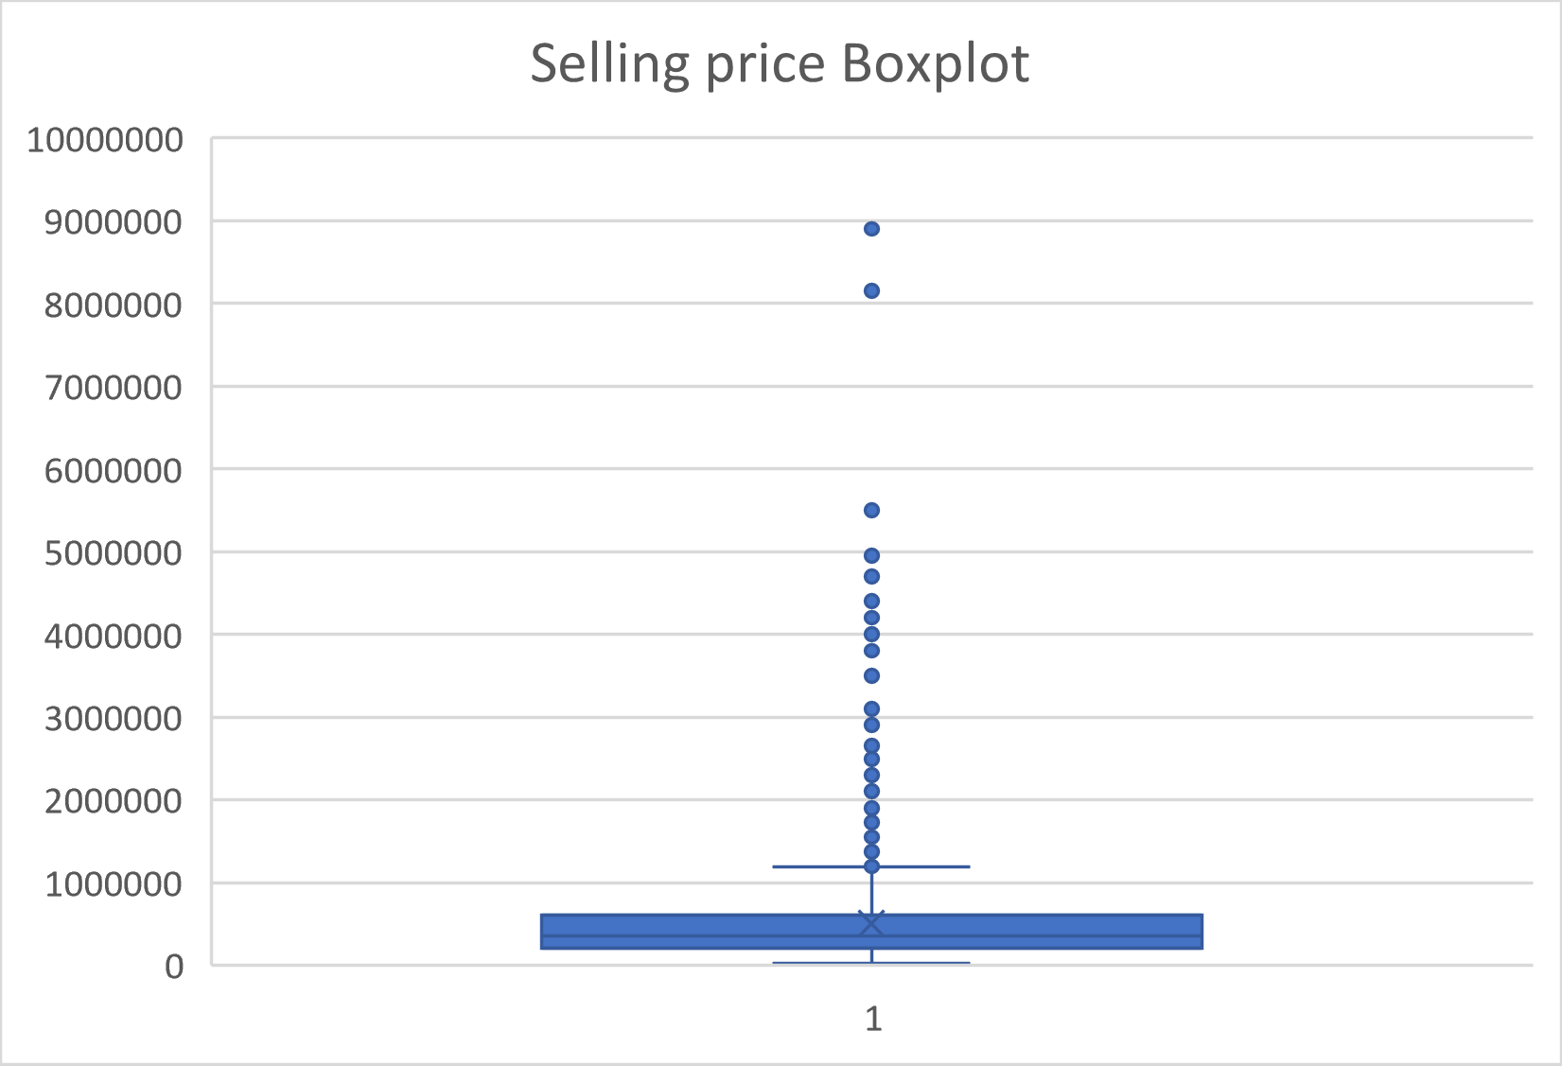
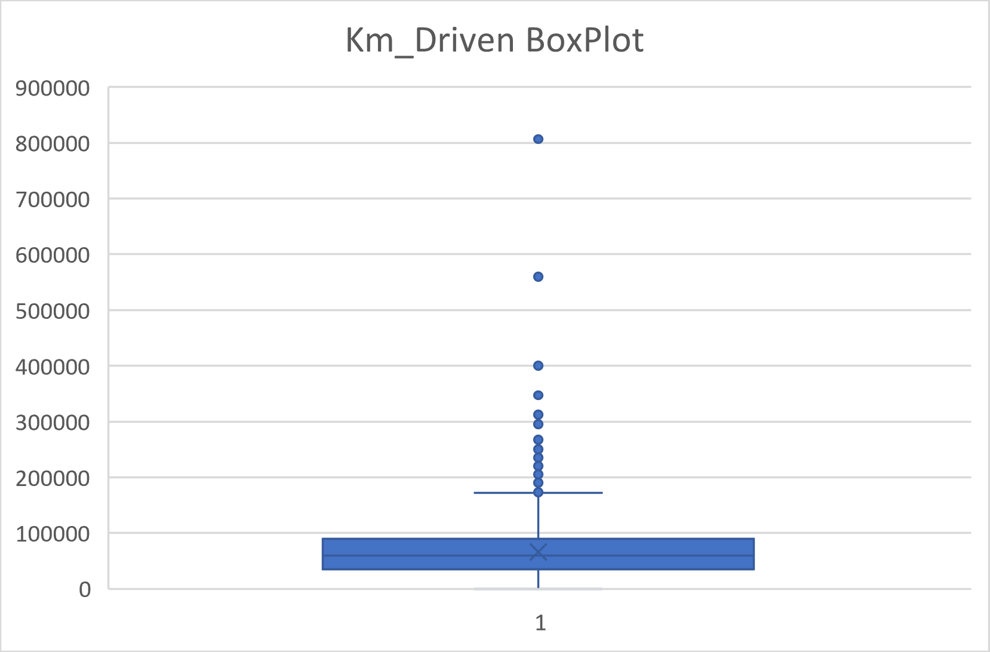

Slide 7
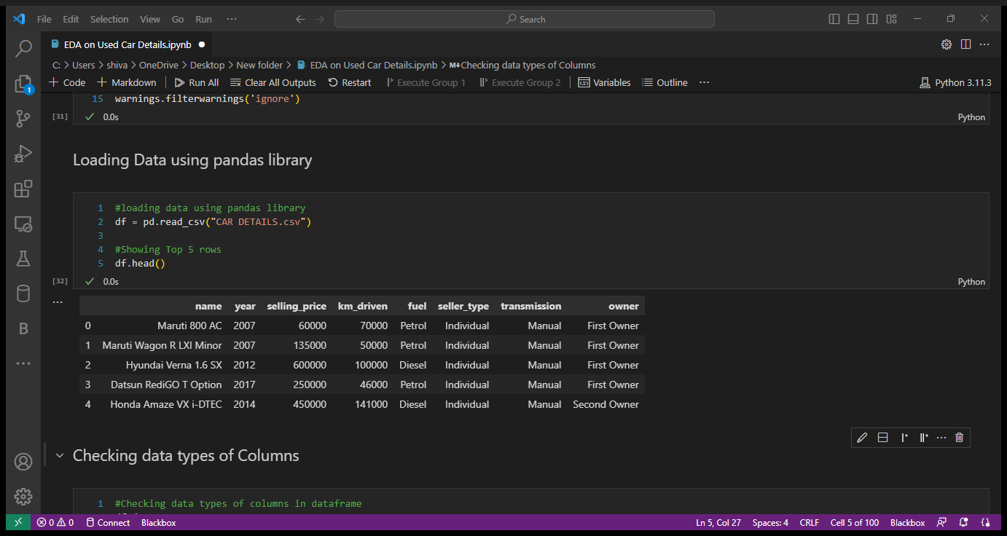
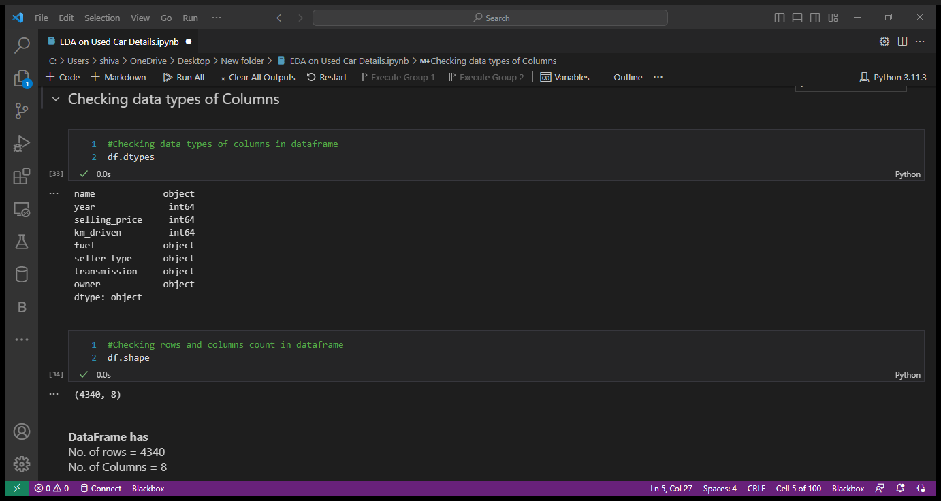
2. EDA and Graphical analysis
Exploratory Data Analysis :-
Loading DataFrame:-
Checking Data types of Columns in Data Frame:-

Slide 8
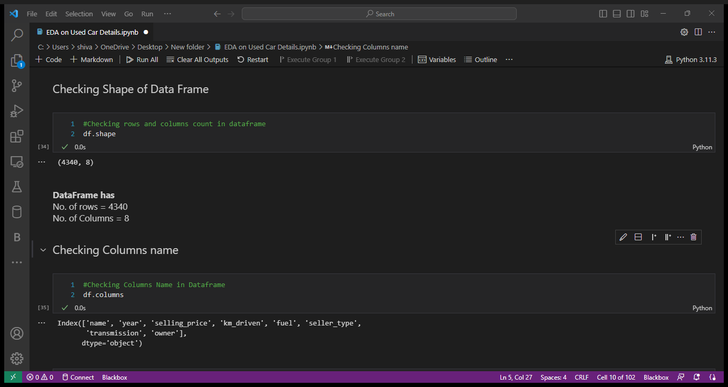
Checking Shape and Columns name in Data Frame:-

Slide 9
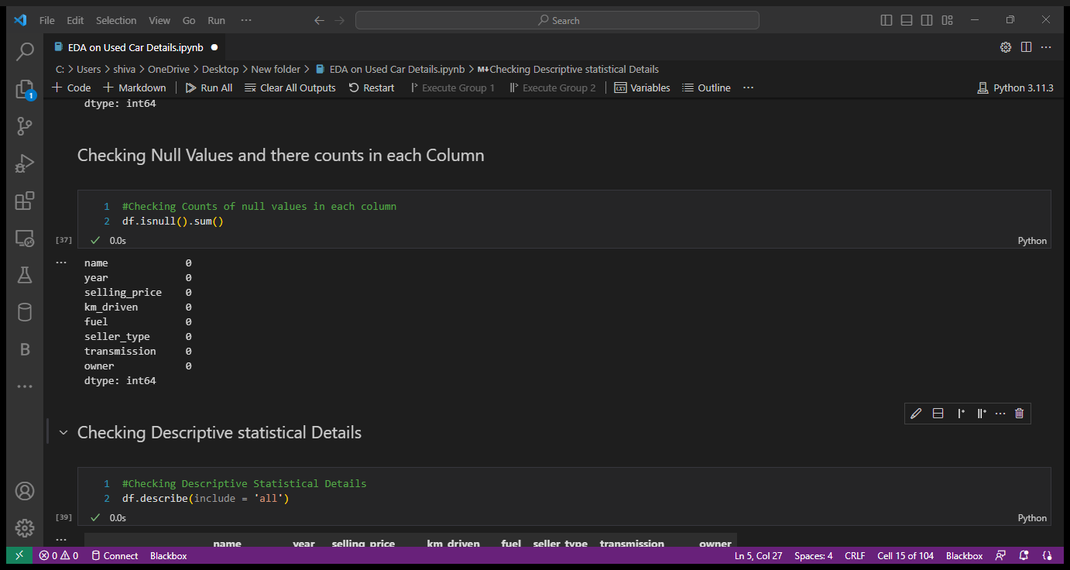
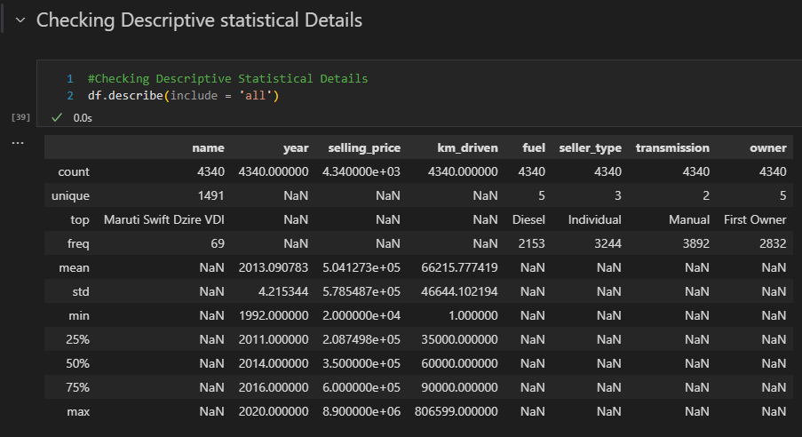
Null Values and there counts:-
Checking Descriptive Details of Dataset:-

Slide 10
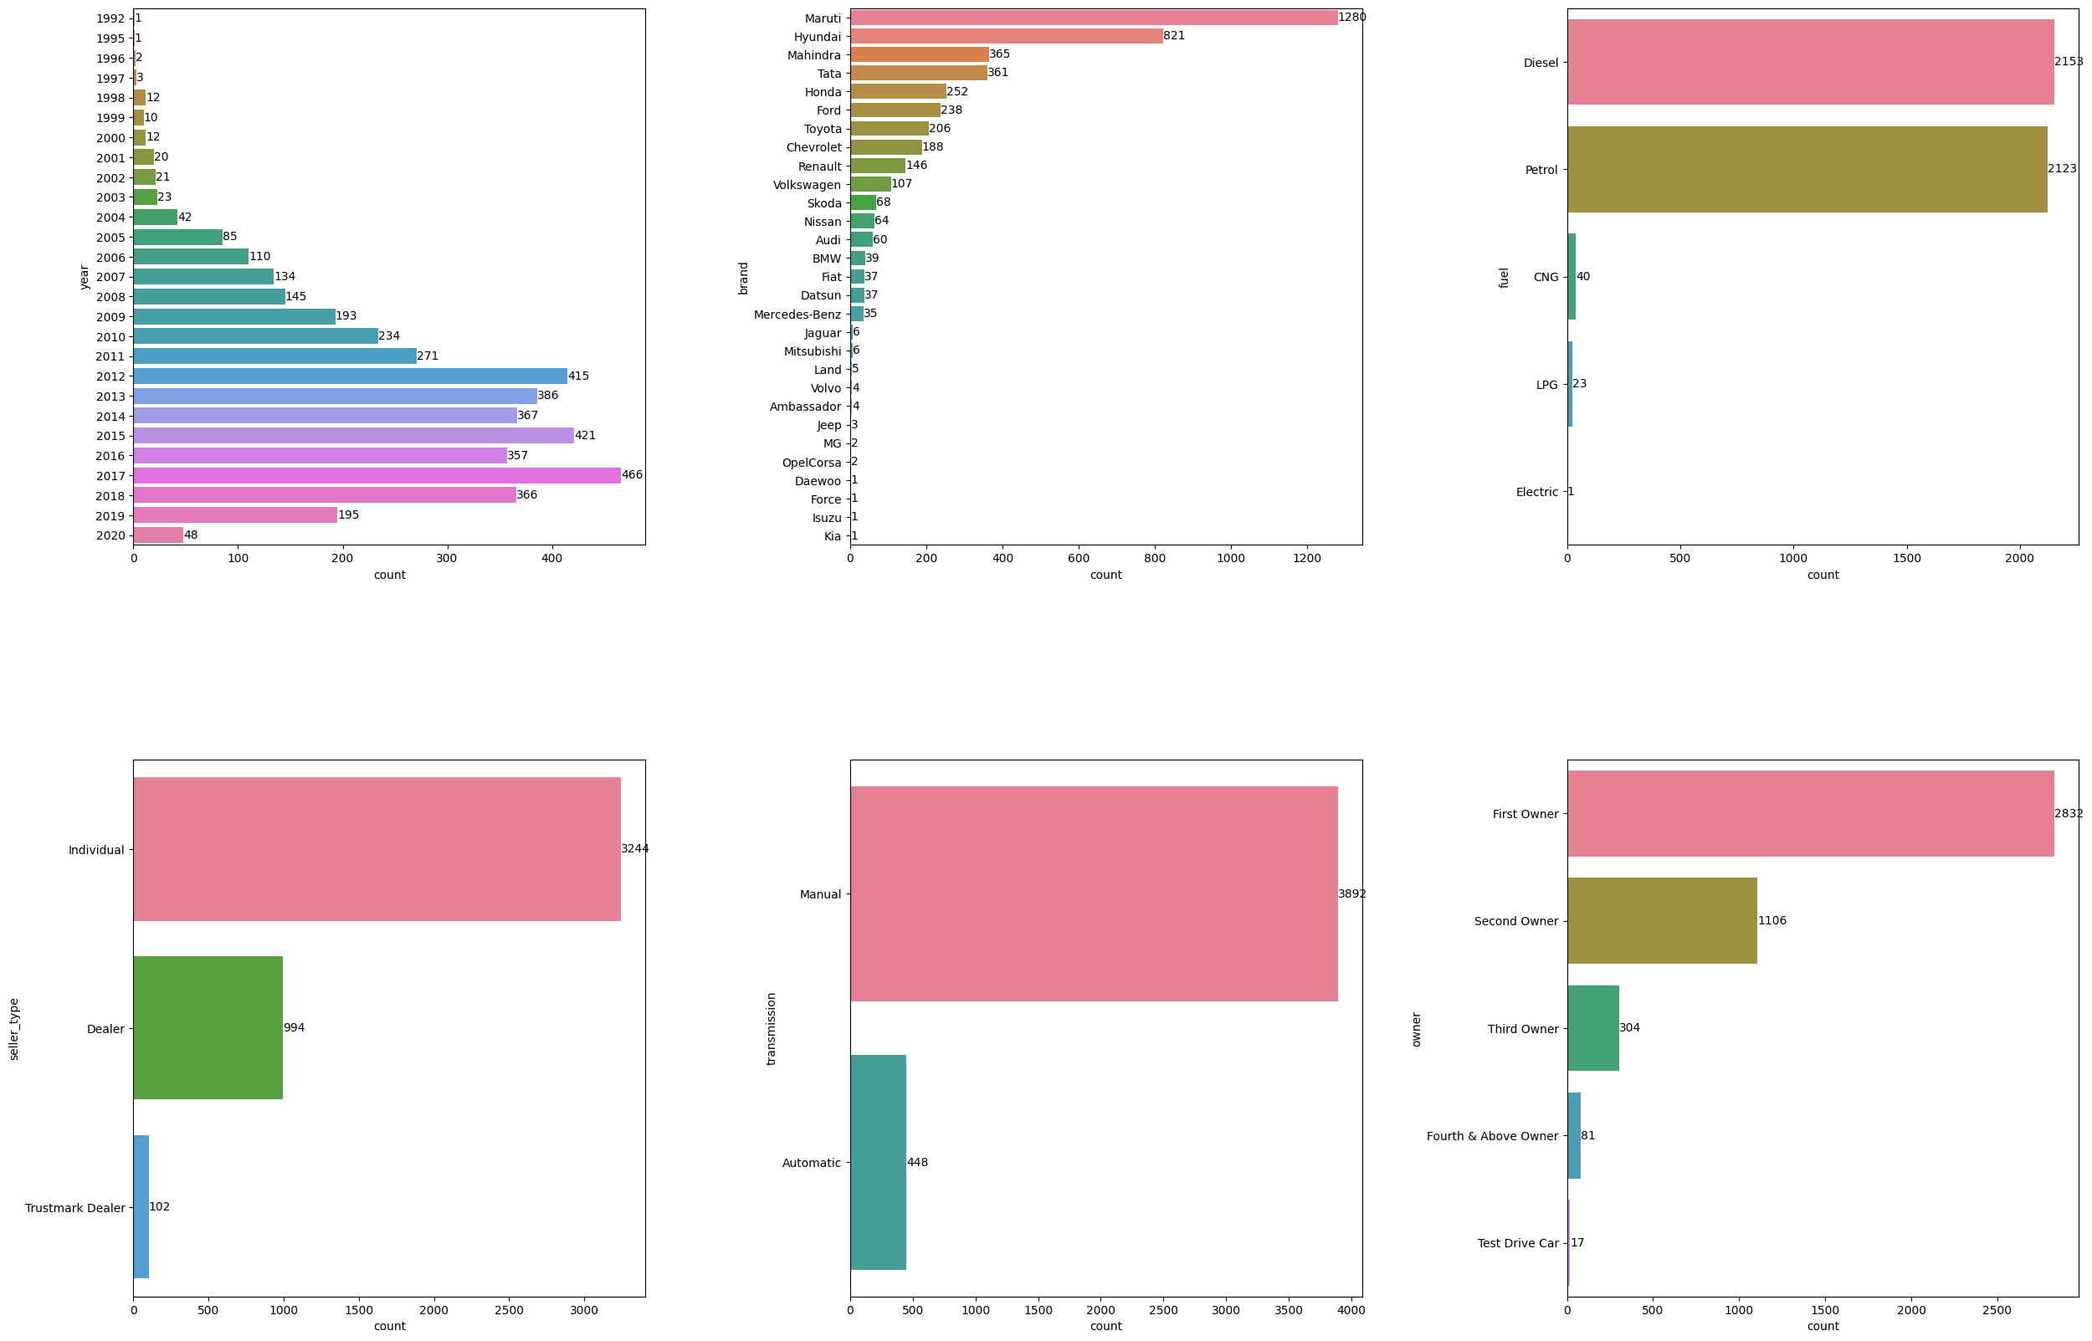
Univariate Graphical Analysis of Categorical Columns in Data set with the unique values and counts:-

Slide 11
Insights:-
Maruti and Hyundai brands has highest sales followed by Mahindra and Tata , while Mahindra and Tata has almost equal sales count.
Most car brand model are of Diesel and petrol fuel type. And Diesel and Petrol fuel type having almost equal count.
Most of the car brands have Individual seller type which means that the most that are selling are being used for personal use followed by Dealer Seller type which are used for test drive purpose.
Maximum car brands that has been sold having high count of Manual Transmission type as compare to Automatic Transmission.
Most car that are sold their buyers prefer First owner as 1st preference followed by Second owner for buying a Car.

Slide 12
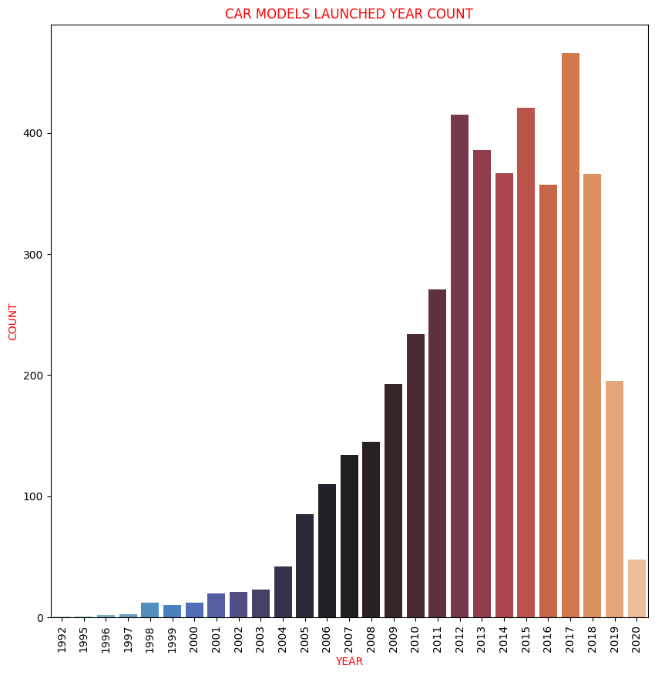
Graphical Analysis:-
Car Brands Launched Year Counts :-
Insight:-
From Plot we see that 2017 year models of car brands having highest sales count followed by 2012, 2015, 2013, 2018 year models of car brands then their is sudden drop in sales count for year 2019 and 2020 models of car brands.

Slide 13
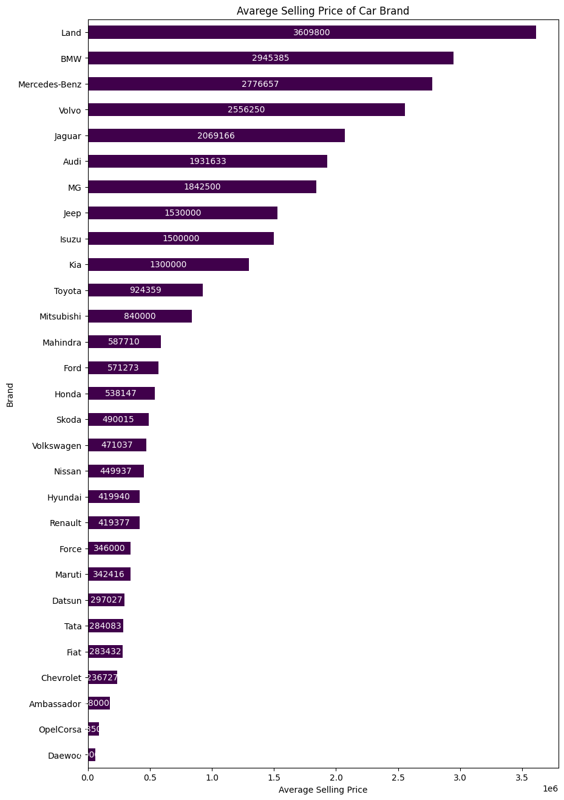
Brand Wise average Selling Price:-
Insights:-
As per graph we can say that brands like Land Rover, BMW, Mercedes-Benz, Volvo, Jaguar, Audi has the highest average selling price as compare to Brands having High sales counts like Maruti, Hyundai, Mahindra, Tata.

Slide 14
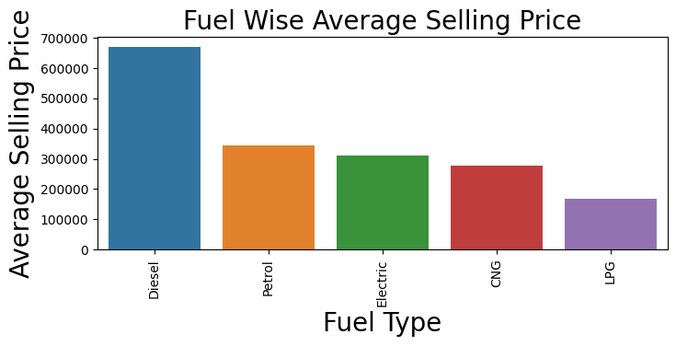
Fuel Wise All brands Average Selling Price:-
Insights:-
So, it is clearly seen from the graph that as per fuel type Diesel model of Car brands has highest average selling price even it just double as compared to Petrol models of Car brand. It need more analysis.

Slide 15
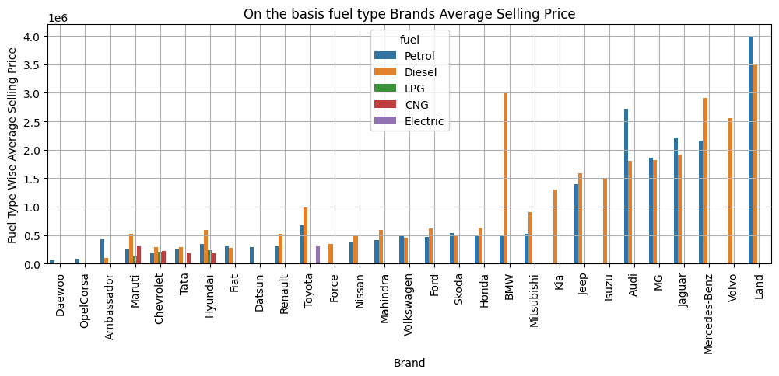
Fuel Wise Average Selling Price of Brands:-

Slide 16
Insights:-
On the basis of Graph it can be see that brands like Land Rover, Audi, Jaguar, Mercedes-Benz and Jeep having high average selling price of petrol Model as compare to brands having high sales count like Maruti, Hyundai , Mahindra and Tata.
While in diesel Fuel type Models of Brand also Land Rover, BMW, Mercedes-Benz, Volvo, Jaguar, MG, Audi and Jeep having high average selling price as compare to models of brands Maruti, Hyundai , Mahindra and Tata.
Because of Car Brand Land Rover, BMW, Mercedes-Benz, Volvo, Jaguar, MG, Audi and Jeep which are luxurious Foreign Car brands average selling price for Diesel Fuel Type is high as these car brands having high sales counts of Diesel model in comparison with Petrol model.
In other hand, if we see the graph of average selling price of brand Land Rover, Audi, Jaguar having high selling price as on the basis of Petrol fuel type compared to Diesel Fuel Type.

Slide 17
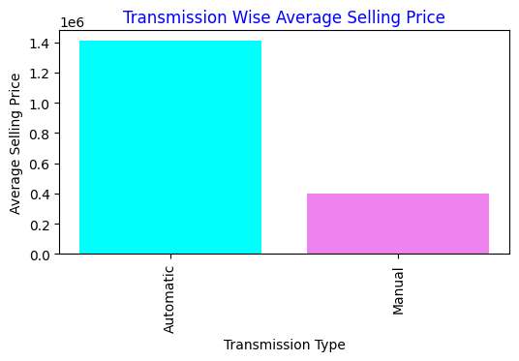
Transmission Wise All brands Average Selling Price:-
Insights:-
As per graph it is clear that average selling price of Automatic Transmission is around ₹ 1000000 high as compare to Manual Transmission and in general also we know that Automatic Transmission is costly as compare to Manual Transmission.
We need to analysis it more.

Slide 18
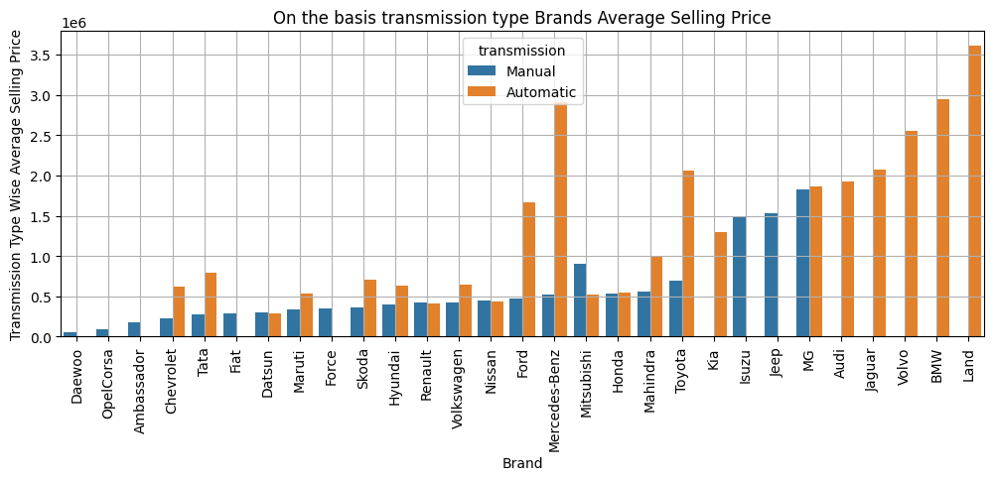
Transmission Wise Average Selling Price of Brands:-

Slide 19
Insights:-
Car Brands Land Rover, BMW, Volvo, Jaguar, Audi, MG, Kia, Toyota, Mercedes-Benz and Ford having model with Automatic transmission having high Average selling price as compare to Manual transmission. But Brands Maruti, Hyundai, Mahindra and Tata having high sales count their automatic transmission model is also available in cheaper price as compare to these brands .
Top 5 highest average selling price of car brands with Manual Transmission are MG, Jeep, Isuzu, Mitsubishi, Toyota, while Top 5 highest average selling price car brands with Automatic Transmission are Land Rover, BMW, Mercedes-Benz, Volvo, Jaguar.

Slide 20
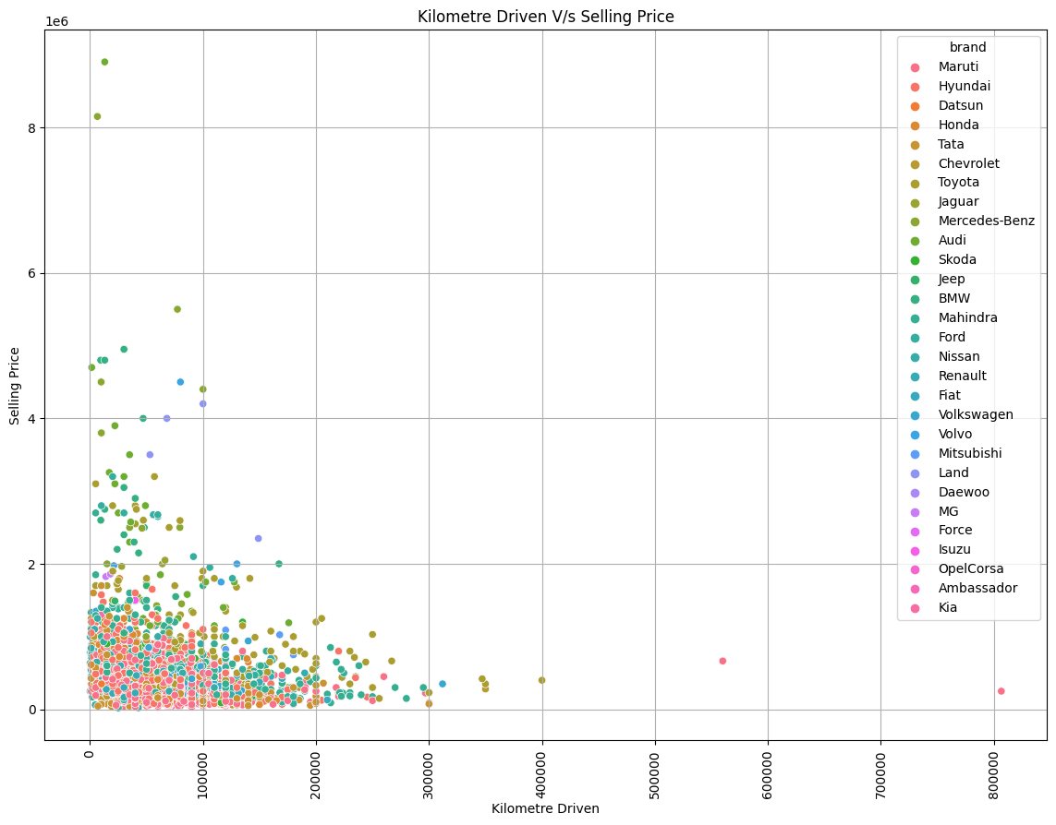
Relation between Kilometre Driven of Car Brands vs Selling Price:-

Slide 21
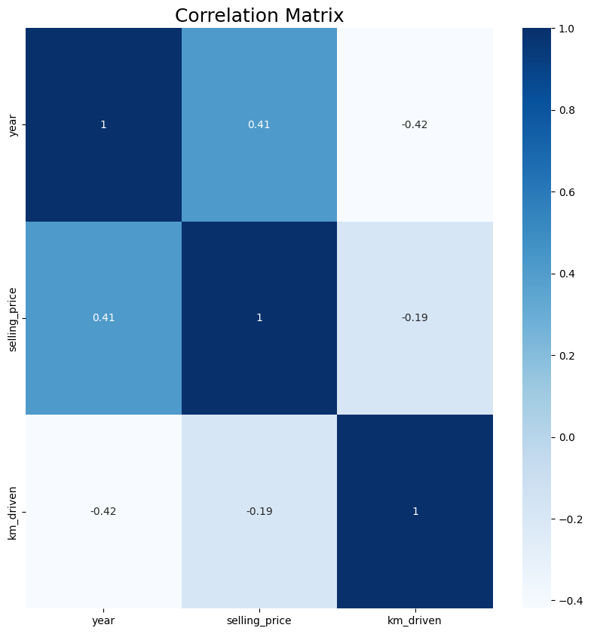
Correlation between Kilometre Driven vs Selling Price vs Year launched of Car Brands :-
Insights:-
There's a positive (but not too strong) correlation between the selling prices and the years, which makes perfect sense, as the car become newer its price becomes higher.
There's a negative but very weak correlation between the selling prices and the Kms. driven, which also makes perfect sense.

Slide 22
Conclusion:-
Maruti, Hyundai, Mahindra and Tata having highest sales count and low average selling price which shows that companies Maruti, Hyundai, Mahindra and Tata have the biggest market share, and that indicates the reliability of their cars and their major spread across different budget ranges with the variety of their models.
While Diesel and Petrol car models having almost equal and highest sales count, Diesel car models high sales followed by Petrol Car models but their is huge difference in their average selling price of Diesel and Petrol Car Models because of reason that Diesel Model is slightly costly as compare to Petrol car models and also some luxurious car brands which has most model having diesel fuel type as compare to petrol and due to their high average selling price too we see the affect the average selling price of diesel car models.
Most of the Car models having high sales counts are Launched in between 2012 to 2018 year, while 2017 year launched Car models having high sales count.
Car models having Manual Transmission having high sales count as compare to Automatic transmission Car models. Transmission has also plays important role in cars selling price, Manual transmission having high sales count but having low selling price as compared to Automatic Transmission because Automatic transmission is costly as compared to Manual Transmission.
Most sales Count for car brands are belongs to First owner followed by second owner, which means that most buyer where interested in First and second owner type but for car brands like Maruti, Hyundai, Mahindra and Tata having high sales count and owner has not show that much effect on these brands.
There is Positive Correlation between Year and Selling Price, on which we can as the Year of launch increases or more the recent launched year higher the selling price is, while in terms of kilometers driven and selling price negative correlation exist which show that if car has more mileage then it has lesser selling price.
Reference Python notebook file of EDA:-
EDA File Of Used Car Details on Github
EDA File Of Used Car on Google Drive

Slide 23
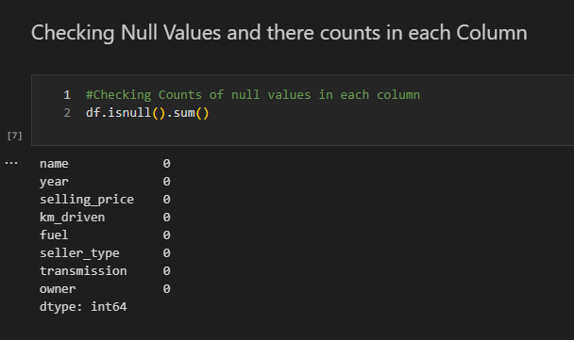
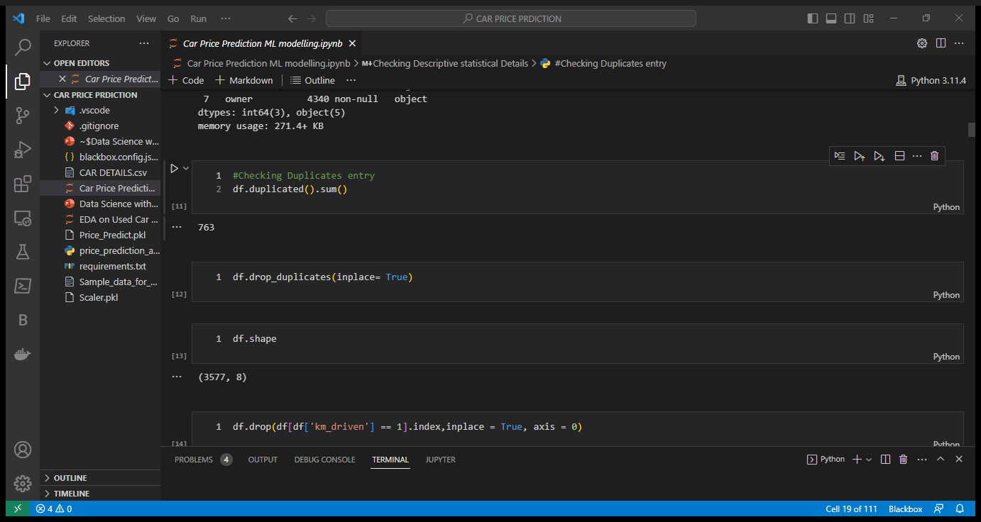
3. Data Cleaning and Data Preprocessing
Data Cleaning :-
Steps involve in data cleaning are:-
Checking Null Values if present then remove it with mean or median for numerical data types columns and with mode or some other separate representative value for categorical datatypes column, but in our dataset there is no null value has been present.
Checking for duplicates and removing them from data set that can produce redundancy due to which model prediction has been to biased or wrong.

Slide 24
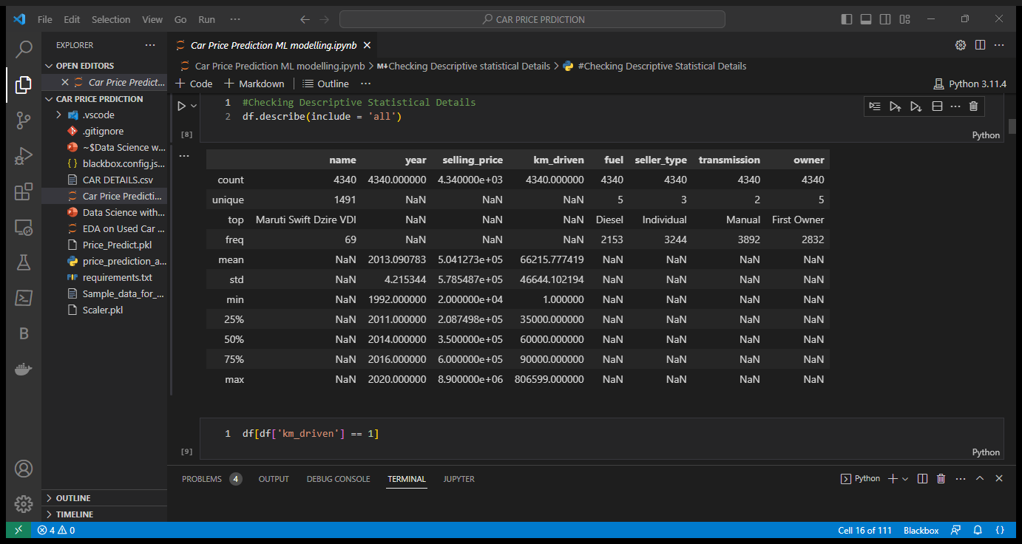
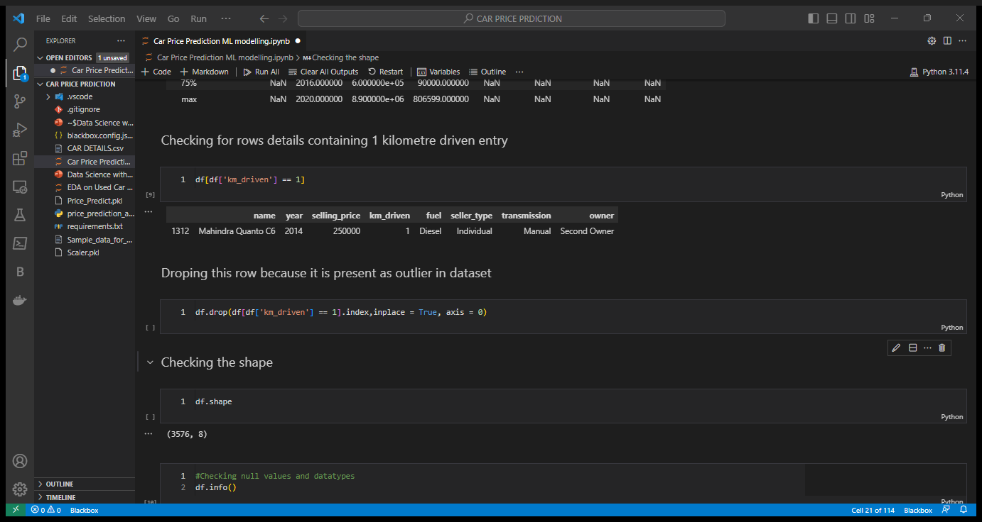
Checking Descriptive statistical details of dataset for checking 25%,50%,75% quantiles, max and min for numerical columns and frequency or mode of unique values present in categorical column.
As we can see, there is a entry in kilometre driven column which shows minimum kilometre driven by some brand of car is 1 km which is somehow not correct, so lets check the car brand if possible replace kilometre with correct value or simply drop the row containing wrong value as a outlier.

Slide 25
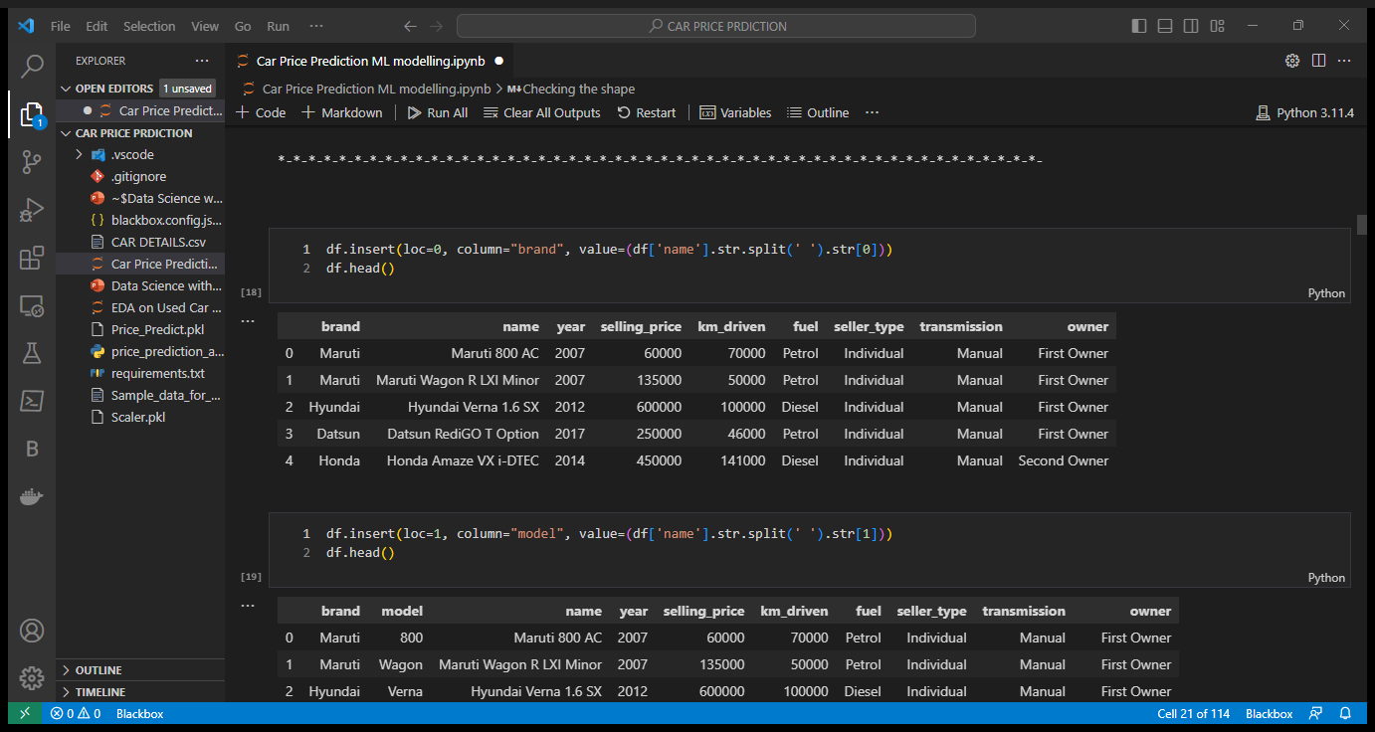
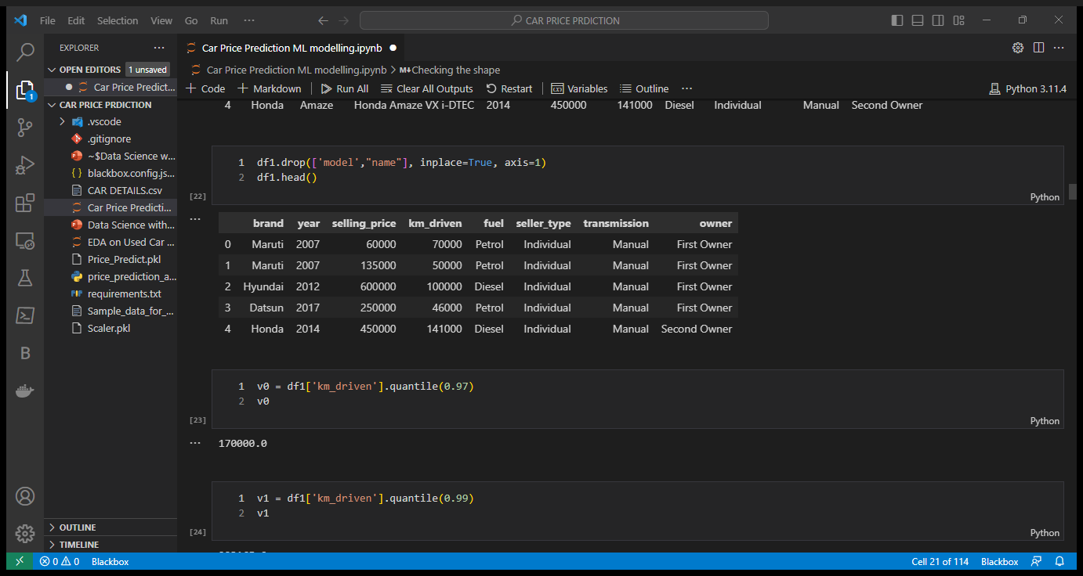
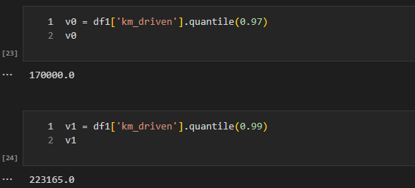
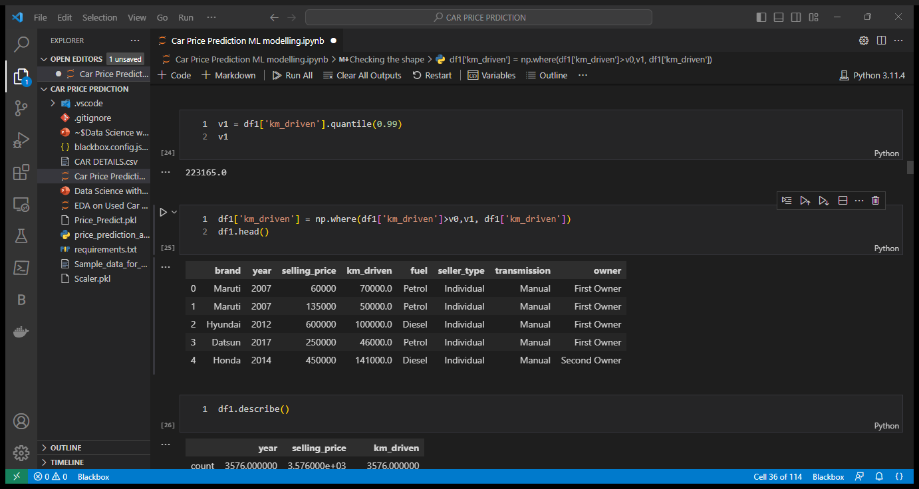
Splitting Brand name from name column and simply dropping name column as we have to use brands name only for machine learning modelling for price prediction of that car brand.
Checking Descriptive statistical details of dataset for checking 25%,50%,75% quantiles, max and min for numerical columns and removing outliers from km_driven column as other numerical contain unique values related to car brands which can affect our machine learning modelling prediction.

Slide 26
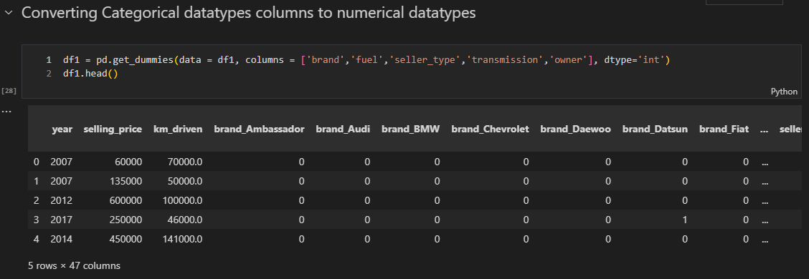
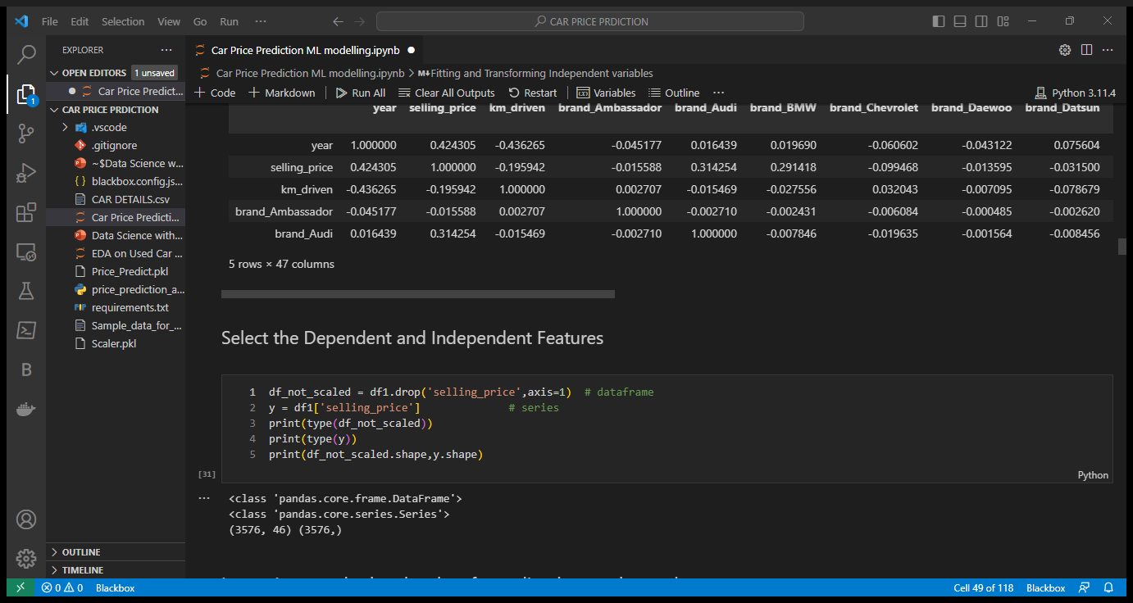
Data Preprocessing:-
Steps involve in data preprocessing are:-
Converting categorical Columns into integer or float type as machine learning models only work on numerical data not on categorical data, we use get_dummies module of pandas library for converting categorical values to numerical values present in categorical columns.
Separating Independent and Dependent variables for feeding in Machine Learning Model so that they can make prediction on dependent variable after training on independent variable.

Slide 27
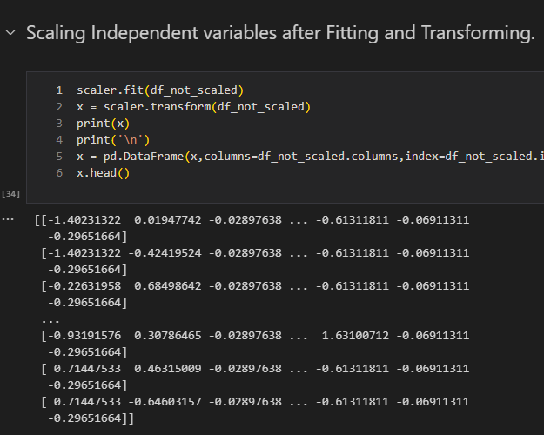
Scaling independent variables to standardize the independent features present in the data in a fixed range. It is performed during the data pre-processing to handle highly varying magnitudes or values or units. If feature scaling is not done, then a machine learning algorithm tends to weigh greater values, higher and consider smaller values as the lower values, regardless of the unit of the values.

Slide 28
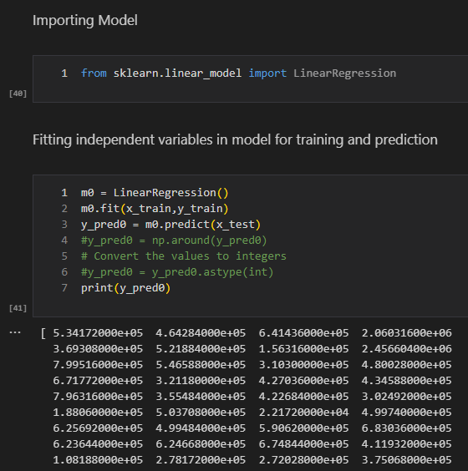
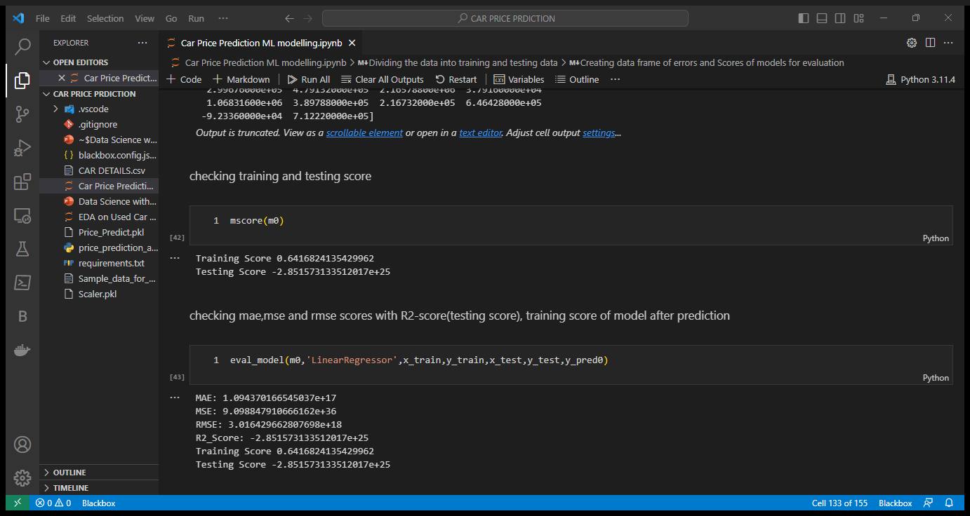
4. Machine Learning Modelling & Model Selection
Feeding Data:-
Feeding Training data and testing data to Machine Learning Model.
Model Training and Prediction:-
Training Linear Regression Model, K-Neighbors Regression Model, Ridge Model, Lasso Model, Decision Tree Regressor Model, Random Forest Regressor Model, Bagging Regressor Model, Ensemble using AdaBoost Regressor Model and Gradient Regressor Models on after training we test the model using testing data and checking Training Score, Testing Score or R2-Score, Mean absolute Error, Mean Squared Error and Root Mean Squared Error and selecting the model having high training and testing score and low Mean Squared Error, Mean Absolute Error and Root Mean Squared Error.
Linear Regression Modelling and Scores:-

Slide 29
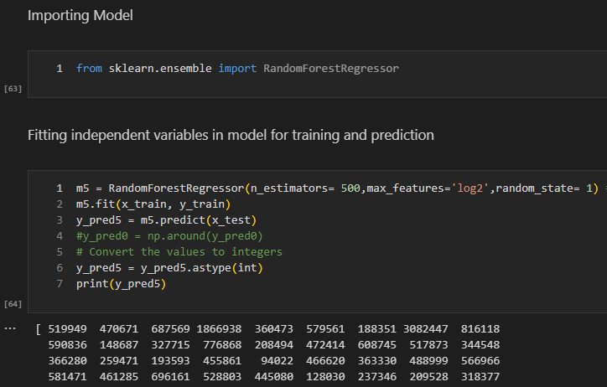
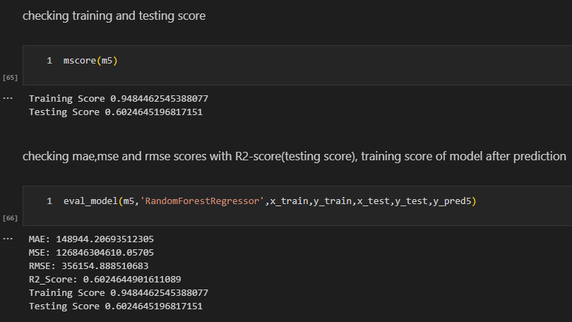
Random Forest Regressor Modelling and Score:-

Slide 30
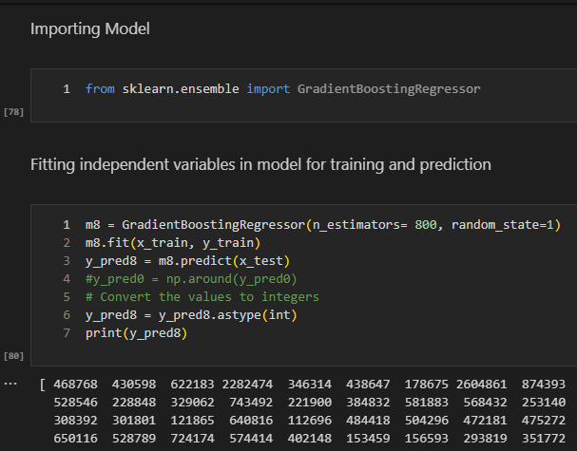
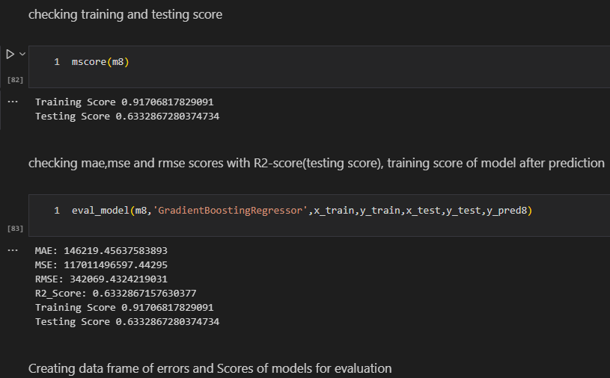
Gradient Boosting Regressor Modelling and Score:-

Slide 31
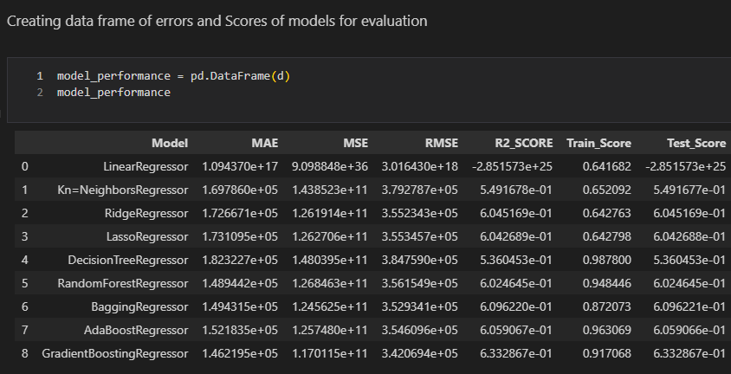
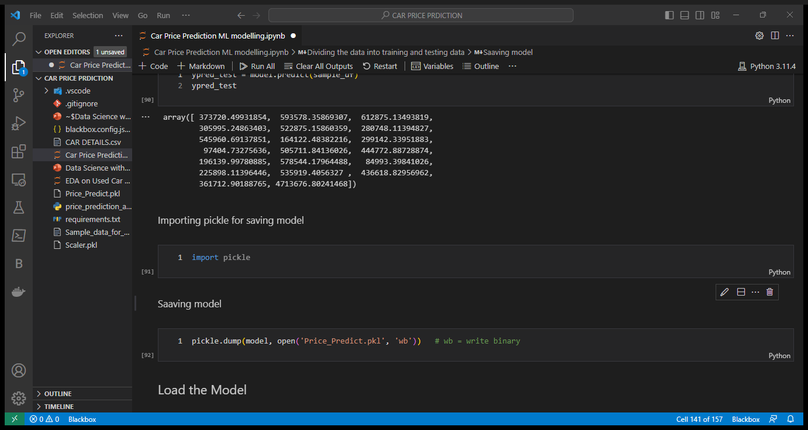
Model Evaluation and Model Selection:-
Creating Data Frame for Model Evaluation using Mean Squared Error, Mean Absolute Error, Root Mean Squared Error, R-2 Score (Testing Score) and Training Score.
Model Saving:-
So, as per the errors and Score mention above we choose Gradient Boosting Regressor Model for Prediction of Price of USED CAR. Saving the Model for price prediction using Pickle.
As per this data frame we choose Gradient Boosting Regressor as best model for Car Price Prediction because it has Lowest MAE, MSE, RMSE and comparatively high R2-Score and Training Score.
MAE – 1.462
MSE - 1.170
RMSE – 3.421
R2 – Score – 0.6333
Training Score - 0.917

Slide 32
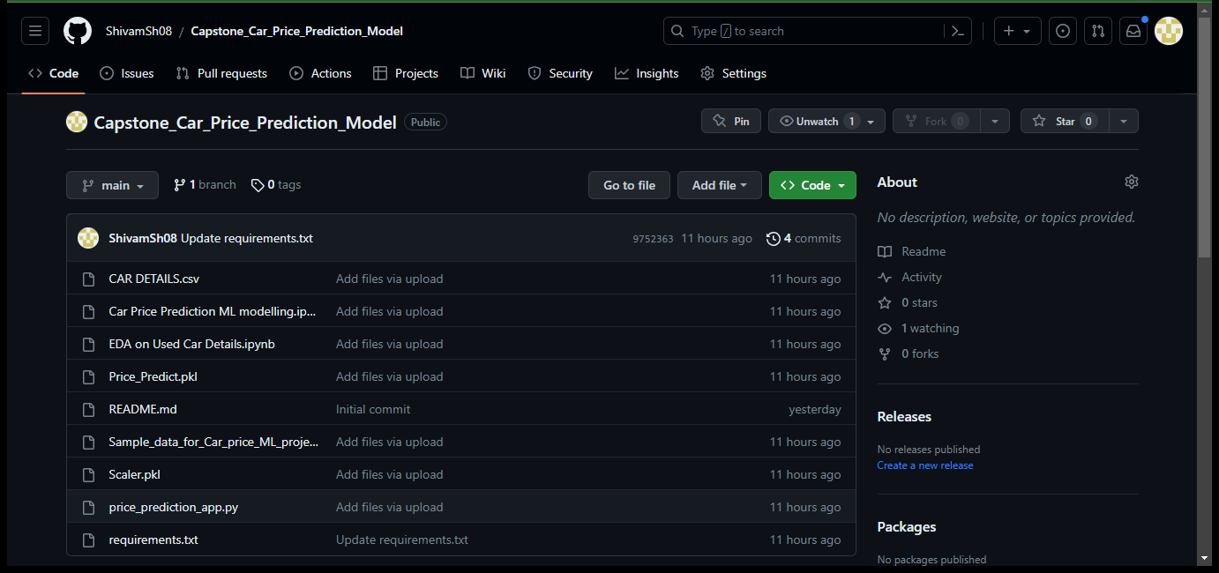
5. Github & Streamlit Website Screenshots and Links
Github Files Screenshot:-

Slide 33
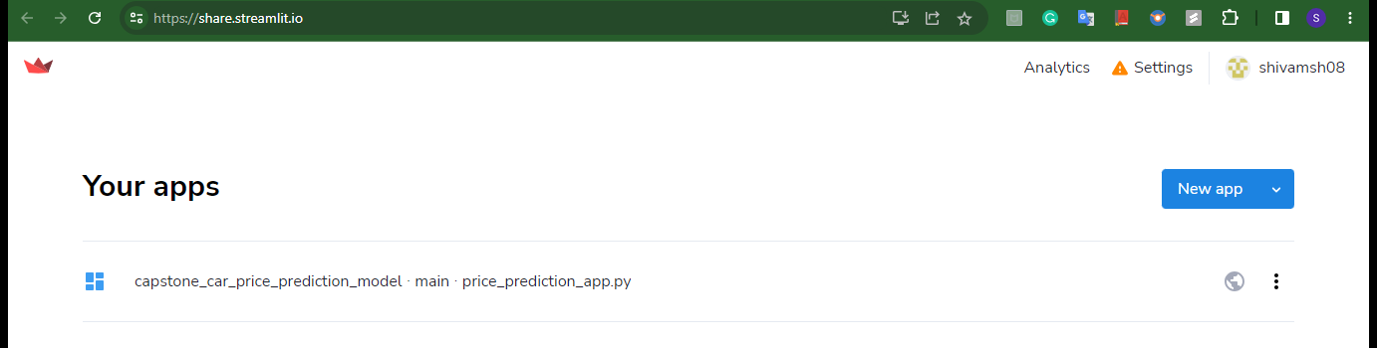
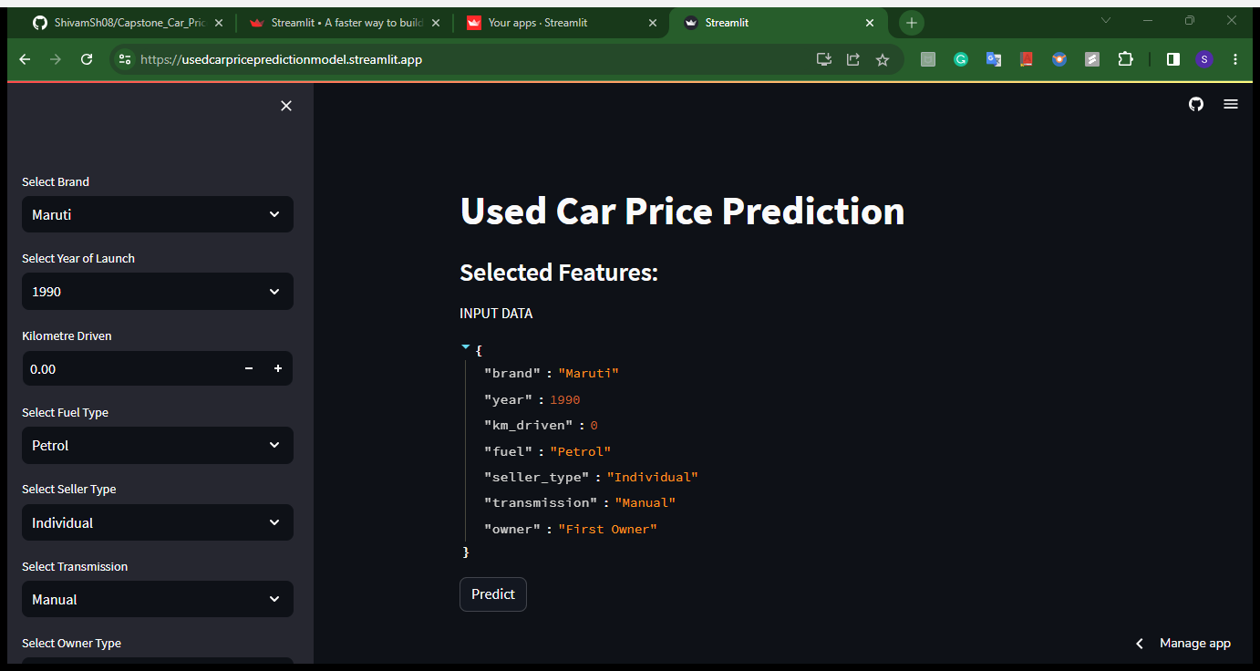
Streamlit Website Screenshot :-

Slide 34
Reference links:-
Reference links of EDA Python file, Price Prediction Modelling Python File, Github Account and Streamlit App Website:-
EDA Python file :-
Exploratory Data Analysis and Visualization File on Github
EDA Python file on Google Drive
Price Prediction Modelling File :-
Car_Price_Prediction_Modelling_File on github
Price Prediction Modelling file on Google Drive
Price Prediction App File:-
Price_Prediction_App File on Github
Price prediction app file on Google Drive
Git Hub Car Price Prediction Repository :- Github Car Price Prediction Repo Link
Streamlit Website :- Used Car Price Prediction Website
Thank you For Viewing.

